Slide 1
Communication and Communication Styles
Communication is a two-way process.
TRANSMISSION OF MESSAGE
SENDER } {
or } MEDIA CHANNEL { RECEIVER
} {
COMMUNI- } {
CATOR} }
FEED BACK
Communication is therefore a two-way Process:
“Communication is a Process (a Transaction) wherein messages between a Sender
and a Receiver are transmitted through a media with a Feed-back.” Dr. George Ninan

Slide 2
BARRIERS TO COMMUNICATION
Noise Transmission of Message Noise
Language /
Attitudes /
Childhood
Upbringing /
SENDER } CHANNEL/ Knowledge / CHANNEL/ { RECEIVER
or } or MEDIA Culture / or MEDIA { or
SPEAKER } Prejudices / {LISTENER
Perceptions /
Memories
FEEDBACK
Noise Barrier Barrier Noise

Slide 3
BARRIERS TO COMMUNICATION
In a family situation, the husband or wife has to therefore cut through these barriers in communication in every situation, especially in conflict situations.
In a marriage, many a time the actual message gets lost and, misunderstandings crop up and multiply between the couple.
‘The biggest communication problem is we do not listen to
understand. We listen to reply.’ Whatsapp.

Slide 4
Communication Styles
Violent communication
Non-Verbal / Verbal Communication
Para-phrasing a sentence Cultivating
Non-Violent Communication

Slide 5
Pro 17:27
‘A man (or woman ) of knowledge uses words with restraint, and a man of understanding is even-tempered’ Pro 17:27
{Especially in counselling }

Slide 6
CONFLICT RESOLUTION according to Neil T. Anderson
When the objective between the couples in conflict, is, to win the argument, then the communication turns into an argument by one of the couple, without caring about the damage to the other; the end result here becomes disastrous. Separation or divorce, soon follow.
Those who have a high regard for relationships, seek to resolve conflicts, when they believe something can be accomplished by confrontation.
Care should be taken however, that such confrontation should not be aggressive or with violent communication, or heated arguments.
Confrontation must be done calmly and assertively with the spouse, in order to resolve the conflict and strengthen the relationship with the spouse.

Slide 7
TRUST & FIDELITY
In Matt.5:27-30 Jesus says even if you as much look with lust in your eyes, you have committed (the action) adultery.
Adultery addressed by Jesus – first the thought, then the look then the action, follows. ‘The danger of uncontrolled thoughts is that what you continue to think about, under the right provocation, you will one day do. {Hocking David}
’For a man it is a physical impulse and ‘his desire is aroused’. For a woman it more intensely personal -- based on feelings, romantic talk & situation etc. For a man -- it is physical act, after which the feelings follow, as he opens up his feelings to the woman. For a woman it is the feelings (romance) first must be aroused enough to have sexual desire to enjoy the physical act.
[ Hocking David and Solid Rock Radio, ‘Marriage and Family’, copyright © 1992 by Solid Rock Radio P.O.Box 2800, Orange, Published by Walk Thru The Bible Ministries, Atlanta, Georgia}

Slide 8
FINANCIAL COMPATABILITY
When the role of the ‘the man’ the bread-winner, gets threatened due to his wife too taking up a job,
the conflict in the marriage begins;
he becomes jealous about his wife’s earning capacity, ability, intelligence and her interaction with others (colleagues -- men) in the office/workplace.

Slide 9
Juggling your time
A model wife, mother , daughter in law and working woman
sharing time with children and with in-laws
talk to children explain to them
give them small chores to do
Tell them you love them and appreciate them
Quality time
with family
with husband
family prayer
‘Marriage Altar’ every night

Slide 10
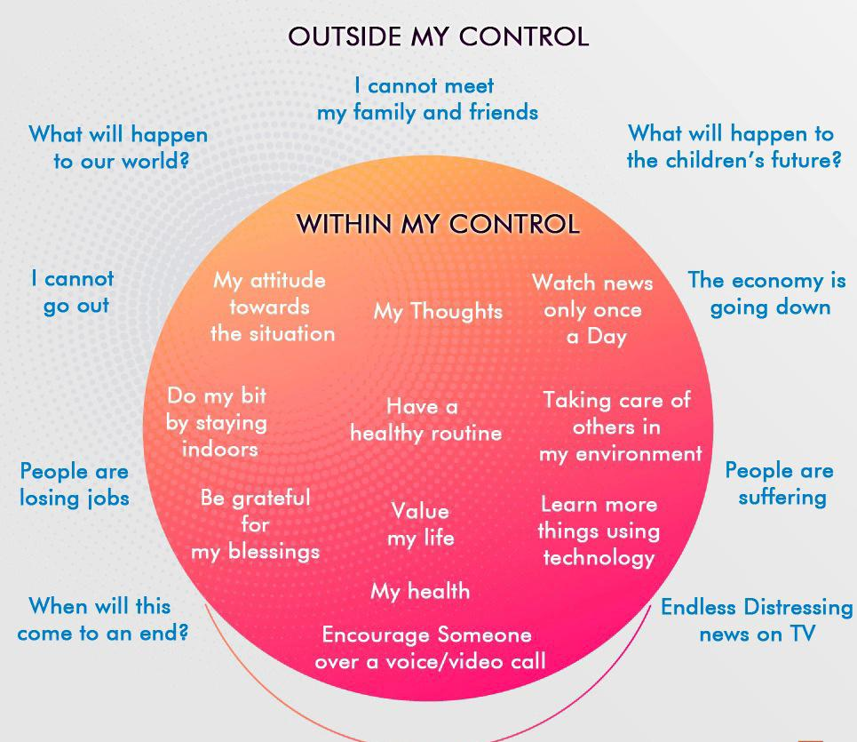
LOCKDOWN TIMES !

Slide 11
Thank you
thank you

